Slide 1
Giga-Lite FPGA Design
Jan. 26 2014
Rev. 2.1
Bibo Yang

Slide 2
Ethernet Tester Feature List
Basic T&M functionality of an Ethernet Tester
Delay*
Jitter*
Loss
Throughput
Availability
Automated Test Suite based on the above Basic T&M functionalities
IETF RFC2544
CIR/EIR tests defined in ITU-T Y.1564
Advanced T&M functionality of an Ethernet Tester
Bursty Traffic Generation: CBS/EBS tests defined in ITU-T Y.1564
Protocol Emulation: TCP/UDP, VoIP/IPTV, OAM&P, IEEE 1588 PTP
Auxiliary functionality of an Ethernet Tester
Loopback
Frame Capture & Analysis
“SN+TS+TRIETH” Tag
* One-way delay measurement requires ToD (Time of Day) sync-up between two testers, which relies on GPS/CDMA, 1PPS signal or IEEE 1588 PTP.
*Jitter measurement requires no ToD sync-up between two testers.

Slide 3
FPGA Feature List
Done | To Do
1000 Mbps Wire-Speed Processing | L1/L2/L3/L4 Loopback w/ Filter
PHY MDIO Control/Status
RJ45 Interface 10/100/1000 Mbps | SFP Interface 100/1000 Mbps
L2/L3/L4 Header Gen/Parsing (IPv6)
Tx Traffic Control (Throughput/Y.1564)
“SN+TS+TRIETH” Tag
8 Test+1 Non-Test Stream Stat
CPU Non-Test Packet Tx | CPU Non-Test Packet Rx w/ Filter
Configurable Payload Pattern
Error Detect/Inject
SPI Interface

Slide 4
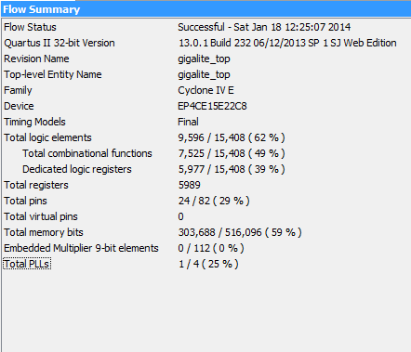
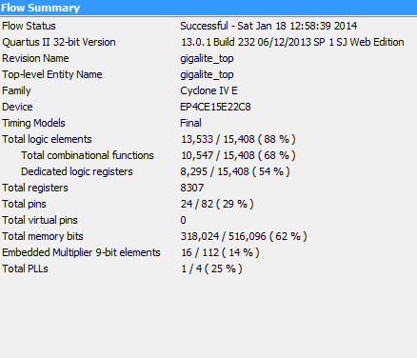
FPGA Resource Usage
Throughput w/ Y.1564 CIR/EIR
(can be fitted into EP4CE10)
(can be fitted into EP4CE15)
Throughput w/ Y.1564 CIR/EIR & CBS/EBS
(cannot be fitted into EP4CE10)
(can be fitted into EP4CE15)

Slide 5
FPGA
Auxiliary Circuits
Control Path
Statistic Queues & Counters
FPGA Configuration
VJTAG
PLL
Data Path
USB to SPI Chip
Tx
Rx
CPU Emulator
Traffic Control
L1 to L4 Loopback
CPU I/F
Frame Generator
Frame Parser
SPI
PHY MDIO
32b to 8b
8b to 32b
SDR to DDR
DDR to SDR
RGMII
PHY Chip
RJ45
SFP
FPGA Architecture

Slide 6
DUT
Control Path
Statistic Queues & Counters
PLL
Data Path
BFM CPU
Tx
Rx
Traffic Control
L1 to L4 Loopback
CPU I/F
cpu_bfm.txt
Frame Generator
Frame Parser
PHY MDIO
32b to 8b
8b to 32b
SDR to DDR
DDR to SDR
RGMII
BFM MDIO
BFM RGMII
FPGA Testbench
phy_rgmii_tx_record.pcap
phy_rgmii_rx_source.pcap

Slide 7
FPGA Clock Scheme
2.5MHz
MDIO PHY Control
PLL
100MHz
System Timer
OSC. 25MHz
50MHz
CPU Emulator
SPI CLK
Statistic Counters
50MHz
Tx Traffic Control
RGMII 2.5MHz/25MHz/125MHz RX_CLK
Tx Frame Generator
Loopback
Rx Frame Parser
1000Mbps Datapath Bandwidth:
4b DDR
@125MHz
8b SDR
@125MHz
32b SDR @125MHz
w/ 4 clock multi-cycle
10/100Mbps Datapath Bandwidth:
4b SDR @2.5/25MHz
4b SDR @2.5/25MHz
32b SDR @2.5/25MHz
w/ 4 clock multi-cycle

Slide 8
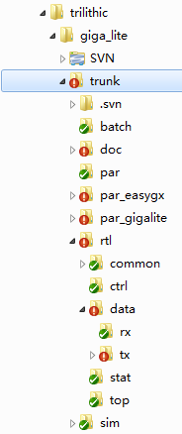
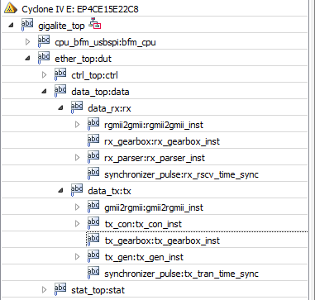
FPGA Project Structure

Slide 9
FPGA Operation Procedure
Hardware Init*
Test Session Setup*
Test Session Start*
Test Session In-Progress*
Test Session Stop
Read Statistic Results
* Details on next page.

Slide 10
FPGA Operation Procedure (cnt’d)
Hardware Init
Test Session Setup
Test Session Start
Power Up & Download FPGA
Set Tx Bandwidth* &
Frame Length
Clear “tx_start” bit
Clear Tx & Rx Statistic Counters
FPGA Soft Reset
Set Tx Frame Header Length & Content*
PHY Hard Reset
Set “tx_start” bit
Set Tx Statistic Parameters
PHY Configuration
Test Session In-Progress
Set FPGA Link-Speed & Link-Status
Update Statistic Results
Tx/Rx CPU Packet
* Details on following pages.
Insert Tx Errors

Slide 11
FPGA Operation Procedure (cnt’d)
Bandwidth Equation
(BWconfigReg[31:16]/2^16)*BWfreq = Packet/Sec = WireSpeed*BW/((FrameLength+8)*8+96)
Bandwidth Configuration Register value calculation
BWconfigReg[31:16] = 2^16*(WireSpeed*BW)/((FrameLength+8)*8+96)/Bwfreq
For example: 64Byte, 1000Mbps, Bandwidth = 12.5% = 0.125
BWconfigReg[31:16] = 2^16*(1000*10^6*0.125/((64+8)*8+96))/(50*10^6) = 243 = 0x00F3
To use the full scale of the BWconfigReg, which is 16bit, a scale factor is added
ScaleFactor*BWconfigReg[31:16] = ScaleFactor*2^16*(WireSpeed*BW)/((FrameLength+8)*8+96)/Bwfreq
So actual BWconfigReg[31:16] should be multiplied with ScaleFactor, and the new BWconfigReg[31:16] will be configured along with ScaleFactor[31:0]
ScaleFactor = 30000/oldBWconfigReg[31:16], 3000 is approximation of 2^(16-1)
newBWconfigReg[31:16] = ScaleFactor*oldBWconfigReg[31:16]
For example: 64Byte, 1000Mbps, Bandwidth = 12.5% = 0.125
oldBWconfigReg[31:16] = 2^16*(1000*10^6*0.125/((64+8)*8+96))/(50*10^6) = 243 = 0x00F3
ScaleFactor = 30000/243 = 123 = 0x0000007B
newBWconfigReg[31:16] = 123* 2^16*(1000*10^6*0.125/((64+8)*8+96))/(50*10^6) = 29988 = 0x7524

Slide 12
FPGA Operation Procedure (cnt’d)
Ethernet testing frame structure
Header + Payload + (16B)“SN+TS+TRIETH” Tag + (5B~8B)Padding + (4B)CRC
Tx side Frame Header structure (Must be filled correctly by SW)
2B PayloadType + 2B HeaderLength
(N*4B+2B) HeaderContent + 2B PayloadType
4B Tx Header Statistic Information [63:32]
4B Tx Header Statistic Information [31:00]
Stream 3, for example | [31:16] | [15:00]
0x04000300 | PayloadType (2B) | HeaderLength (2B)
0x04000300+4 ~ 0x04000300+HeaderLength | HeaderContent (High 2B) …… HeaderContent (High 2B) HeaderContent (High 2B) | HeaderContent (Low 2B) …… HeaderContent (Low 2B) PayloadType (2B)
0x04000000+HeaderLength+4 | Tx Header Statistic Information [63:32] (4B)
0x04000000+HeaderLength+8 | Tx Header Statistic Information [31:00] (4B)

Slide 13
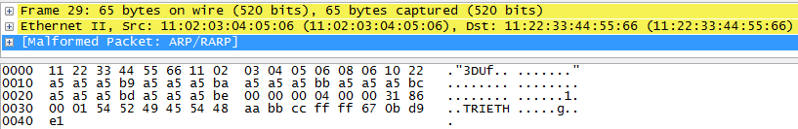
FPGA Operation Procedure (cnt’d)
Format of “SN+TS+TRIETH” tag
Handled by FPGA, no SW needed
Placed in front of “4B TCP checksum compensation” “1B to 4B EoF mod padding” and “4B CRC”
Stream Number, 2B, 0~7
Tx Time Stamp of a Frame, 4B, 0~ 4294967295*10ns
ASCII code “TRIETH”, 6B
Sequence Number in a Stream, 4B, 0~ 4294967295

Slide 14
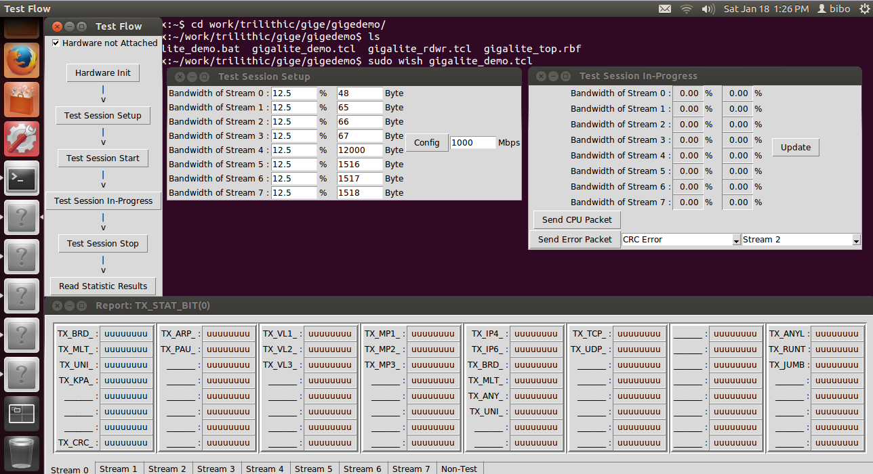
Demo for the operation procedure
A flow-chart style GUI
Recommended for SW engineer to write low-level FPGA access functions
Not recommended for final products
A set of scripts
Pseudo-code for a fixed test case

Slide 15
FPGA Memory Map
Base Address 0x000000xx : Control Path
0x00 : MDIO
0x04 : Main Control Register
0x08 : Main Status Register
0x10 : Statistic Counter Last Access Time
Base Address 0x04xxxxxx : Data Path
0x000000 ~ 0x01FFFC : Tx side
0x000010 : Tx Control Register
0x000014 : Tx Status Register
0x000020 ~ 0x00003C : Tx Bandwidth Rate control (For Throughput)
0x001xxx : Tx Information Rate control (For Y.1564 CBS/EBS)
0x010000 ~ 0x010FFC : Tx Frame Header Info Memory: 256B*8 + 2048B
0x020000 ~ 0x03FFFC : Rx side
Base Address 0x08xxxxxx : Statistic Counters
0x000000 ~ 0x000FFC : Tx side BIT based : 4B*64*8 + 4B*64*1 + Undefined 4B*64*7
0x010000 ~ 0x010FFC : Tx side VEC based : 4B*64*8 + 4B*64*1 + Undefined 4B*64*7
0x020000 ~ 0x020FFC : Rx side BIT based : 4B*64*8 + 4B*64*1 + Undefined 4B*64*7
0x030000 ~ 0x030FFC : Rx side VEC based : 4B*64*8 + 4B*64*1 + Undefined 4B*64*7
Base Address 0x0C000000 : Undefined

Slide 16
FPGA Register Definitions (CTRL 1)
0x00000000: MDIO control
Bits | Field | Mode | Description
31:30 | MDIO access direction | R/W | 2=read; 1=write
29 | MDIO access done | R | 1=done
28:24 | PHY chip address | R/W | 01111 is fixed by PCB design
23:21 | Reserved | R/W
20:16 | PHY register address | R/W
15:00 | MDIO access data | R/W

Slide 17
FPGA Register Definitions (CTRL 2)
0x00000004: Global control
Bits | Field | Mode | Description
31:08 | Reserved | R/W | 0x000000xx
07:05 | Reserved | R/W
04 | Statistic counters reset | R/W | 1=reset, poll 0x00000008, then set 0
03:02 | Reserved | R/W
01 | PHY hard reset | R/W | 1=reset, wait 5ms, then set 0
00 | FPGA soft reset | R/W | 1=reset, wait 5ms, then set 0

Slide 18
FPGA Register Definitions (CTRL 3)
0x00000008: Global status
Bits | Field | Mode | Description
31:12 | Reserved | R | 0x00000xxx
11:10 | Reserved | R
09 | FPGA info: giga-mode | R | Reflect 0x00000004
08 | FPGA info: link-up | R | Reflect 0x00000004
07:05 | Reserved | R
04 | Statistic counters reset | R | 1=reset done
03:02 | Reserved | R
01 | PHY hard reset | R | Reflect 0x00000004
00 | FPGA soft reset | R | Reflect 0x00000004

Slide 19
FPGA Register Definitions (CTRL 4)
0x0000000C: Link Status
Bits | Field | Mode | Description
31:04 | Reserved | R/W | 0x0000000x
03:02 | Reserved | R/W
01 | FPGA info: giga-mode | R/W | 1=PHY is in 1000Mbps mode
00 | FPGA info: link-up | R/W | 1=PHY is linked up

Slide 20
FPGA Register Definitions (CTRL 5)
0x00000010: Statistic counter access time record
Bits | Field | Mode | Description
31:00 | Last stat counter access time | R | 10ns unit, round up every 43s

Slide 21
FPGA Register Definitions (DATA TX 1)
0x04000010: Tx control
Bits | Field | Mode | Description
31:20 | Reserved | R/W | 0x000xxxxx
19:17 | Reserved | R/W
16 | Inject error control | R/W | 1=inject, poll 0x04000014, set 0
15:12 | Inject error target stream | R/W | 0~7=8 streams
11:08 | Inject error type | R/W | 0=CRC; 1=BIT; 3=L4; 4=LOS (loss of sequence); 5=OOS (out of sequence); 6=DUP (duplicate of sequence)
07:04 | Reserved | R/W
03 | Enable Y.1564 test | R/W | 1=enable Y.1564
02 | Send CPU Non-Test packet | R/W | 1=send. After poll 0x04000014, set 0
01 | Enable “TRIETH” tag | R/W | 1=enable, should always set 1
00 | Tx test start | R/W | 1=start; 0=stop

Slide 22
FPGA Register Definitions (DATA TX 2)
0x04000014: Tx status
Bits | Field | Mode | Description
31:20 | Reserved | R | 0x000xxxxx
19:17 | Reserved | R
16 | Inject error done | R | 1=inject error done
15:12 | Inject error target stream | R | Reflect 0x04000010
11:08 | Inject error type | R | Reflect 0x04000010
07:04 | Reserved | R
03 | Enable Y.1564 test | R | Reflect 0x04000010
02 | Send CPU Non-Test packet | R | 1=CPU packet sent
01 | Enable “TRIETH” tag | R | Reflect 0x04000010
00 | Tx test start | R | Reflect 0x04000010

Slide 23
FPGA Register Definitions (DATA TX 3)
0x04000020: (stream 0) Tx bandwidth and frame length control
0x04000024: (stream 1) Tx bandwidth and frame length control
0x04000028: (stream 2) Tx bandwidth and frame length control
0x0400002c: (stream 3) Tx bandwidth and frame length control
0x04000030: (stream 4) Tx bandwidth and frame length control
0x04000034: (stream 5) Tx bandwidth and frame length control
0x04000038: (stream 6) Tx bandwidth and frame length control
0x0400003c: (stream 7) Tx bandwidth and frame length control
Bits | Field | Mode | Description
31:16 | Bandwidth Incremental Rate | R/W | See Operation Procedure Note
15:00 | Frame Length in Byte | R/W | Currently supports 48~12000 Byte

Slide 24
FPGA Register Definitions (DATA TX 3)
0x04000040: (stream 0) Tx bandwidth scale factor
0x04000044: (stream 1) Tx bandwidth scale factor
0x04000048: (stream 2) Tx bandwidth scale factor
0x0400004c: (stream 3) Tx bandwidth scale factor
0x04000050: (stream 4) Tx bandwidth scale factor
0x04000054: (stream 5) Tx bandwidth scale factor
0x04000058: (stream 6) Tx bandwidth scale factor
0x0400005c: (stream 7) Tx bandwidth scale factor
Bits | Field | Mode | Description
31:00 | Scale Factor | R/W | See Operation Procedure Note

Slide 25
FPGA Register Definitions (DATA TX 4)
0x04000000: (stream 0) Tx frame header configuration information
0x04000100: (stream 1) Tx frame header configuration information
0x04000200: (stream 2) Tx frame header configuration information
0x04000300: (stream 3) Tx frame header configuration information
0x04000400: (stream 4) Tx frame header configuration information
0x04000500: (stream 5) Tx frame header configuration information
0x04000600: (stream 6) Tx frame header configuration information
0x04000700: (stream 7) Tx frame header configuration information
Bits | Field | Mode | Description
31:28 | Payload type | R/W | 0~3: const, incr, decr, const; 4~7: 2e31, 2e23,2e15,2e11
27:24 | Reserved | R/W
23:16 | Payload seed Byte | R/W | Seed of payload type 0~3
15:00 | Header length in Byte | R/W | Currently supports 14:4:248 Byte. All L2~L4 header content is (4m+2) Byte long, and [31:16] of 0x04000x00 is padded to the header content as a payload indication tag. So this value must be L2~L4 HeaderLength + 2 = 4n Byte.

Slide 26
FPGA Register Definitions (DATA TX 5)
0x04000000+4 ~ 0x04000000+HeaderLength : (stream 0) Tx frame header content
0x04000100+4 ~ 0x04000100+HeaderLength : (stream 1) Tx frame header content
0x04000200+4 ~ 0x04000200+HeaderLength : (stream 2) Tx frame header content
0x04000300+4 ~ 0x04000300+HeaderLength : (stream 3) Tx frame header content
0x04000400+4 ~ 0x04000400+HeaderLength : (stream 4) Tx frame header content
0x04000500+4 ~ 0x04000500+HeaderLength : (stream 5) Tx frame header content
0x04000600+4 ~ 0x04000600+HeaderLength : (stream 6) Tx frame header content
0x04000700+4 ~ 0x04000700+HeaderLength : (stream 7) Tx frame header content
Bits | Field | Mode | Description
31:00 | Header content | R/W | All L1~L4 header is (4n+2) Byte long, and [31:16] of 0x04000x00 is padded to the header content as a payload indication tag.

Slide 27
FPGA Register Definitions (DATA TX 6)
0x04000000+HeaderLength+4: (stream 0) Tx frame statistic configuration [63:32]
0x04000100+HeaderLength+4: (stream 1) Tx frame statistic configuration [63:32]
0x04000200+HeaderLength+4: (stream 2) Tx frame statistic configuration [63:32]
0x04000300+HeaderLength+4: (stream 3) Tx frame statistic configuration [63:32]
0x04000400+HeaderLength+4: (stream 4) Tx frame statistic configuration [63:32]
0x04000500+HeaderLength+4: (stream 5) Tx frame statistic configuration [63:32]
0x04000600+HeaderLength+4: (stream 6) Tx frame statistic configuration [63:32]
0x04000700+HeaderLength+4: (stream 7) Tx frame statistic configuration [63:32]
Bits | Field | Mode | Description
31 | Tx stat MAC_Broadcast | R/W | MAC Des_Addr is Broadcast
30 | Tx stat MAC_Multicast | R/W | MAC Des_Addr is Multicast
29 | Tx stat MAC_Unicast | R/W | MAC Des_Addr is Unicast
28 | Tx stat Keep_Alive | R/W | MAC Des_Addr = Src_Addr
27:24 | Reserved | R/W
23 | Tx stat MAC_ARP | R/W | MAC Type is ARP
22 | Tx stat MAC_Pause | R/W | MAC Type is Pause
21:20 | Reserved | R/W
19:16 | Reserved | R/W
15 | Tx stat VLAN 1 | R/W | 1 VLAN Stacking is sent
14 | Tx stat VLAN 2 | R/W | 2 VLAN Stacking is sent
13 | Tx stat VLAN 3 | R/W | 3 VLAN Stacking is sent
12 | Reserved | R/W
11:08 | Reserved | R/W
07 | Tx stat MPLS 1 | R/W | 1 MPLS Stacking is sent
06 | Tx stat MPLS 2 | R/W | 1 MPLS Stacking is sent
05 | Tx stat MPLS 3 | R/W | 1 MPLS Stacking is sent
04 | Reserved | R/W
03:00 | Reserved | R/W

Slide 28
FPGA Register Definitions (DATA TX 7)
0x04000000+HeaderLength+8: (stream 0) Tx frame statistic configuration [31:0]
0x04000100+HeaderLength+8: (stream 1) Tx frame statistic configuration [31:0]
0x04000200+HeaderLength+8: (stream 2) Tx frame statistic configuration [31:0]
0x04000300+HeaderLength+8: (stream 3) Tx frame statistic configuration [31:0]
0x04000400+HeaderLength+8: (stream 4) Tx frame statistic configuration [31:0]
0x04000500+HeaderLength+8: (stream 5) Tx frame statistic configuration [31:0]
0x04000600+HeaderLength+8: (stream 6) Tx frame statistic configuration [31:0]
0x04000700+HeaderLength+8: (stream 7) Tx frame statistic configuration [31:0]
Bits | Field | Mode | Description
31 | Tx stat IPv4 | R/W | IP version is v4
30 | Tx stat IPv6 | R/W | IP version is v6
29 | Tx stat IP_Broadcast | R/W | IP Des_Addr is Broadcast
28 | Tx stat IP_Multicast | R/W | IP Des_Addr is Multicast
27 | Tx stat IP_Anycast | R/W | IP Des_Addr is Anycast
26 | Tx stat IP_Unicast | R/W | IP Des_Addr is Unicast
25:24 | Reserved | R/W
23 | Tx stat IP_TCP | R/W | IP Type is TCP
22 | Tx stat IP_UDP | R/W | IP Type is UDP
21:20 | Reserved | R/W
19:00 | Reserved | R/W

Slide 29
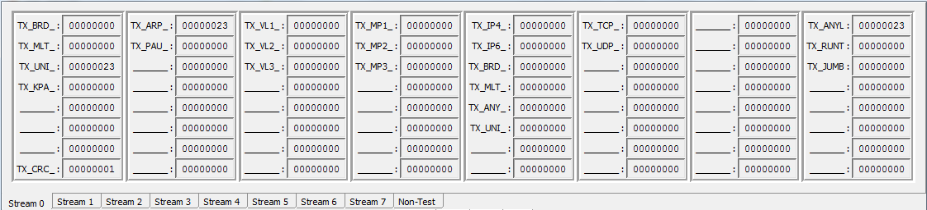
FPGA Register Definitions (STAT TX-BIT 1)
Address | Description
0x08000000+StrNo.*256 | MAC Broadcast
0x08000004+StrNo.*256 | MAC Multicast
0x08000008+StrNo.*256 | MAC Unicast
0x0800000C+StrNo.*256 | MAC Keep-alive
0x08000010+StrNo.*256 | Reserved
0x08000014+StrNo.*256 | Reserved
0x08000018+StrNo.*256 | Reserved
0x0800001C+StrNo.*256 | MAC CRC error
Address | Description
0x08000020+StrNo.*256 | MAC Type ARP
0x08000024+StrNo.*256 | MAC Type Pause
0x08000028+StrNo.*256 | Reserved
0x0800002C+StrNo.*256 | Reserved
0x08000030+StrNo.*256 | Reserved
0x08000034+StrNo.*256 | Reserved
0x08000038+StrNo.*256 | Reserved
0x0800003C+StrNo.*256 | Reserved

Slide 30
FPGA Register Definitions (STAT TX-BIT 2)
Address | Description
0x08000040+StrNo.*256 | VLAN 1
0x08000044+StrNo.*256 | VLAN 2
0x08000048+StrNo.*256 | VLAN 3
0x0800004C+StrNo.*256 | Reserved
0x08000050+StrNo.*256 | Reserved
0x08000054+StrNo.*256 | Reserved
0x08000058+StrNo.*256 | Reserved
0x0800005C+StrNo.*256 | Reserved
Address | Description
0x08000060+StrNo.*256 | MPLS 1
0x08000064+StrNo.*256 | MPLS 2
0x08000068+StrNo.*256 | MPLS 3
0x0800006C+StrNo.*256 | Reserved
0x08000070+StrNo.*256 | Reserved
0x08000074+StrNo.*256 | Reserved
0x08000078+StrNo.*256 | Reserved
0x0800007C+StrNo.*256 | Reserved

Slide 31
FPGA Register Definitions (STAT TX-BIT 3)
Address | Description
0x08000080+StrNo.*256 | IPv4
0x08000084+StrNo.*256 | IPv6
0x08000088+StrNo.*256 | IP Broadcast
0x0800008C+StrNo.*256 | IP Multicast
0x08000090+StrNo.*256 | IP Any-cast
0x08000094+StrNo.*256 | IP Unicast
0x08000098+StrNo.*256 | Reserved
0x0800009C+StrNo.*256 | Reserved
Address | Description
0x080000A0+StrNo.*256 | IP Type TCP
0x080000A4+StrNo.*256 | IP Type UDP
0x080000A8+StrNo.*256 | Reserved
0x080000AC+StrNo.*256 | Reserved
0x080000B0+StrNo.*256 | Reserved
0x080000B4+StrNo.*256 | Reserved
0x080000B8+StrNo.*256 | Reserved
0x080000BC+StrNo.*256 | Reserved

Slide 32
FPGA Register Definitions (STAT TX-BIT 4)
Address | Description
0x080000C0+StrNo.*256 | L4 cksum error
0x080000C4+StrNo.*256 | Reserved
0x080000C8+StrNo.*256 | Reserved
0x080000CC+StrNo.*256 | Reserved
0x080000D0+StrNo.*256 | Reserved
0x080000D4+StrNo.*256 | Reserved
0x080000D8+StrNo.*256 | Reserved
0x080000DC+StrNo.*256 | Reserved
Address | Description
0x080000E0+StrNo.*256 | Any length
0x080000E4+StrNo.*256 | Runt length
0x080000E8+StrNo.*256 | Jumbo length
0x080000EC+StrNo.*256 | Reserved
0x080000F0+StrNo.*256 | Reserved
0x080000F4+StrNo.*256 | Reserved
0x080000F8+StrNo.*256 | Reserved
0x080000FC+StrNo.*256 | Reserved

Slide 33
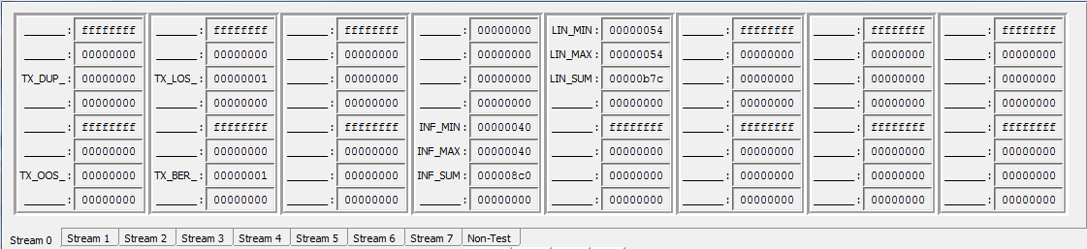
FPGA Register Definitions (STAT TX-VEC 1)
Address | Description
0x08010000+StrNo.*256 | Reserved
0x08010004+StrNo.*256 | Reserved
0x08010008+StrNo.*256 | Duplicate frame
0x0801000C+StrNo.*256 | Reserved
0x08010010+StrNo.*256 | Reserved
0x08010014+StrNo.*256 | Reserved
0x08010018+StrNo.*256 | Out of sequence
0x0801001C+StrNo.*256 | Reserved
Address | Description
0x08010020+StrNo.*256 | Reserved
0x08010024+StrNo.*256 | Reserved
0x08010028+StrNo.*256 | Loss of frame
0x0801002C+StrNo.*256 | Reserved
0x08010030+StrNo.*256 | Reserved
0x08010034+StrNo.*256 | Reserved
0x08010038+StrNo.*256 | Bit error
0x0801003C+StrNo.*256 | Reserved

Slide 34
FPGA Register Definitions (STAT TX-VEC 2)
Address | Description
0x08010040+StrNo.*256 | Reserved
0x08010044+StrNo.*256 | Reserved
0x08010048+StrNo.*256 | Reserved
0x0801004C+StrNo.*256 | Reserved
0x08010050+StrNo.*256 | Reserved
0x08010054+StrNo.*256 | Reserved
0x08010058+StrNo.*256 | Reserved
0x0801005C+StrNo.*256 | Reserved
Address | Description
0x08010060+StrNo.*256 | Reserved
0x08010064+StrNo.*256 | Reserved
0x08010068+StrNo.*256 | Reserved
0x0801006C+StrNo.*256 | Reserved
0x08010070+StrNo.*256 | Min. Info Rate
0x08010074+StrNo.*256 | Max. Info Rate
0x08010078+StrNo.*256 | Total Info Rate
0x0801007C+StrNo.*256 | Reserved

Slide 35
FPGA Register Definitions (STAT TX-VEC 3)
Address | Description
0x08010080+StrNo.*256 | Min. Line Rate
0x08010084+StrNo.*256 | Max. Line Rate
0x08010088+StrNo.*256 | Total Line Rate
0x0801008C+StrNo.*256 | Reserved
0x08010090+StrNo.*256 | Reserved
0x08010094+StrNo.*256 | Reserved
0x08010098+StrNo.*256 | Reserved
0x0801009C+StrNo.*256 | Reserved
Address | Description
0x080100A0+StrNo.*256 | Reserved
0x080100A4+StrNo.*256 | Reserved
0x080100A8+StrNo.*256 | Reserved
0x080100AC+StrNo.*256 | Reserved
0x080100B0+StrNo.*256 | Reserved
0x080100B4+StrNo.*256 | Reserved
0x080100B8+StrNo.*256 | Reserved
0x080100BC+StrNo.*256 | Reserved

Slide 36
FPGA Register Definitions (STAT TX-VEC 4)
Address | Description
0x080100C0+StrNo.*256 | Reserved
0x080100C4+StrNo.*256 | Reserved
0x080100C8+StrNo.*256 | Reserved
0x080100CC+StrNo.*256 | Reserved
0x080100D0+StrNo.*256 | Reserved
0x080100D4+StrNo.*256 | Reserved
0x080100D8+StrNo.*256 | Reserved
0x080100DC+StrNo.*256 | Reserved
Address | Description
0x080100E0+StrNo.*256 | Reserved
0x080100E4+StrNo.*256 | Reserved
0x080100E8+StrNo.*256 | Reserved
0x080100EC+StrNo.*256 | Reserved
0x080100F0+StrNo.*256 | Reserved
0x080100F4+StrNo.*256 | Reserved
0x080100F8+StrNo.*256 | Reserved
0x080100FC+StrNo.*256 | Reserved

Slide 37
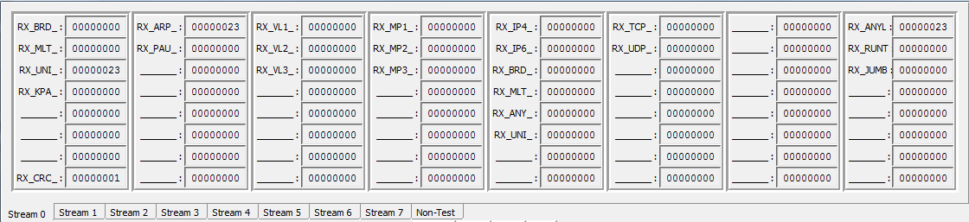
FPGA Register Definitions (STAT RX-BIT 1)
Address | Description
0x08020000+StrNo.*256 | MAC Broadcast
0x08020004+StrNo.*256 | MAC Multicast
0x08020008+StrNo.*256 | MAC Unicast
0x0802000C+StrNo.*256 | MAC Keep-alive
0x08020010+StrNo.*256 | Reserved
0x08020014+StrNo.*256 | Reserved
0x08020018+StrNo.*256 | Reserved
0x0802001C+StrNo.*256 | MAC CRC error
Address | Description
0x08020020+StrNo.*256 | MAC Type ARP
0x08020024+StrNo.*256 | MAC Type Pause
0x08020028+StrNo.*256 | Reserved
0x0802002C+StrNo.*256 | Reserved
0x08020030+StrNo.*256 | Reserved
0x08020034+StrNo.*256 | Reserved
0x08020038+StrNo.*256 | Reserved
0x0802003C+StrNo.*256 | Reserved

Slide 38
FPGA Register Definitions (STAT RX-BIT 2)
Address | Description
0x08020040+StrNo.*256 | VLAN 1
0x08020044+StrNo.*256 | VLAN 2
0x08020048+StrNo.*256 | VLAN 3
0x0802004C+StrNo.*256 | Reserved
0x08020050+StrNo.*256 | Reserved
0x08020054+StrNo.*256 | Reserved
0x08020058+StrNo.*256 | Reserved
0x0802005C+StrNo.*256 | Reserved
Address | Description
0x08020060+StrNo.*256 | MPLS 1
0x08020064+StrNo.*256 | MPLS 2
0x08020068+StrNo.*256 | MPLS 3
0x0802006C+StrNo.*256 | Reserved
0x08020070+StrNo.*256 | Reserved
0x08020074+StrNo.*256 | Reserved
0x08020078+StrNo.*256 | Reserved
0x0802007C+StrNo.*256 | Reserved

Slide 39
FPGA Register Definitions (STAT RX-BIT 3)
Address | Description
0x08020080+StrNo.*256 | IPv4
0x08020084+StrNo.*256 | IPv6
0x08020088+StrNo.*256 | IP Broadcast
0x0802008C+StrNo.*256 | IP Multicast
0x08020090+StrNo.*256 | IP Any-cast
0x08020094+StrNo.*256 | IP Unicast
0x08020098+StrNo.*256 | Reserved
0x0802009C+StrNo.*256 | Reserved
Address | Description
0x080200A0+StrNo.*256 | IP Type TCP
0x080200A4+StrNo.*256 | IP Type UDP
0x080200A8+StrNo.*256 | Reserved
0x080200AC+StrNo.*256 | Reserved
0x080200B0+StrNo.*256 | Reserved
0x080200B4+StrNo.*256 | Reserved
0x080200B8+StrNo.*256 | Reserved
0x080200BC+StrNo.*256 | Reserved

Slide 40
FPGA Register Definitions (STAT RX-BIT 4)
Address | Description
0x080200C0+StrNo.*256 | L4 cksum error
0x080200C4+StrNo.*256 | Reserved
0x080200C8+StrNo.*256 | Reserved
0x080200CC+StrNo.*256 | Reserved
0x080200D0+StrNo.*256 | Reserved
0x080200D4+StrNo.*256 | Reserved
0x080200D8+StrNo.*256 | Reserved
0x080200DC+StrNo.*256 | Reserved
Address | Description
0x080200E0+StrNo.*256 | Any length
0x080200E4+StrNo.*256 | Runt length
0x080200E8+StrNo.*256 | Jumbo length
0x080200EC+StrNo.*256 | Reserved
0x080200F0+StrNo.*256 | Reserved
0x080200F4+StrNo.*256 | Reserved
0x080200F8+StrNo.*256 | Reserved
0x080200FC+StrNo.*256 | Reserved

Slide 41
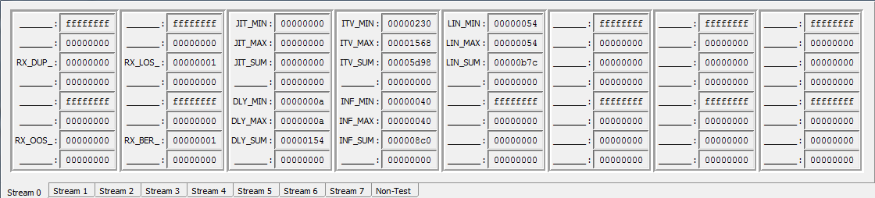
FPGA Register Definitions (STAT RX-VEC 1)
Address | Description
0x08030000+StrNo.*256 | Reserved
0x08030004+StrNo.*256 | Reserved
0x08030008+StrNo.*256 | Duplicate frame
0x0803000C+StrNo.*256 | Reserved
0x08030010+StrNo.*256 | Reserved
0x08030014+StrNo.*256 | Reserved
0x08030018+StrNo.*256 | Out of sequence
0x0803001C+StrNo.*256 | Reserved
Address | Description
0x08030020+StrNo.*256 | Reserved
0x08030024+StrNo.*256 | Reserved
0x08030028+StrNo.*256 | Loss of frame
0x0803002C+StrNo.*256 | Reserved
0x08030030+StrNo.*256 | Reserved
0x08030034+StrNo.*256 | Reserved
0x08030038+StrNo.*256 | Bit error
0x0803003C+StrNo.*256 | Reserved

Slide 42
FPGA Register Definitions (STAT RX-VEC 2)
Address | Description
0x08030040+StrNo.*256 | Min. Jitter
0x08030044+StrNo.*256 | Max. Jitter
0x08030048+StrNo.*256 | Total Jitter
0x0803004C+StrNo.*256 | Reserved
0x08030050+StrNo.*256 | Min. Delay
0x08030054+StrNo.*256 | Max. Delay
0x08030058+StrNo.*256 | Total Delay
0x0803005C+StrNo.*256 | Reserved
Address | Description
0x08030060+StrNo.*256 | Min. Interval
0x08030064+StrNo.*256 | Max. Interval
0x08030068+StrNo.*256 | Total Interval
0x0803006C+StrNo.*256 | Reserved
0x08030070+StrNo.*256 | Min. Info Rate
0x08030074+StrNo.*256 | Max. Info Rate
0x08030078+StrNo.*256 | Total Info Rate
0x0803007C+StrNo.*256 | Reserved

Slide 43
FPGA Register Definitions (STAT RX-VEC 3)
Address | Description
0x08030080+StrNo.*256 | Min. Line Rate
0x08030084+StrNo.*256 | Max. Line Rate
0x08030088+StrNo.*256 | Total Line Rate
0x0803008C+StrNo.*256 | Reserved
0x08030090+StrNo.*256 | Reserved
0x08030094+StrNo.*256 | Reserved
0x08030098+StrNo.*256 | Reserved
0x0803009C+StrNo.*256 | Reserved
Address | Description
0x080300A0+StrNo.*256 | Reserved
0x080300A4+StrNo.*256 | Reserved
0x080300A8+StrNo.*256 | Reserved
0x080300AC+StrNo.*256 | Reserved
0x080300B0+StrNo.*256 | Reserved
0x080300B4+StrNo.*256 | Reserved
0x080300B8+StrNo.*256 | Reserved
0x080300BC+StrNo.*256 | Reserved

Slide 44
FPGA Register Definitions (STAT RX-VEC 4)
Address | Description
0x080300C0+StrNo.*256 | Reserved
0x080300C4+StrNo.*256 | Reserved
0x080300C8+StrNo.*256 | Reserved
0x080300CC+StrNo.*256 | Reserved
0x080300D0+StrNo.*256 | Reserved
0x080300D4+StrNo.*256 | Reserved
0x080300D8+StrNo.*256 | Reserved
0x080300DC+StrNo.*256 | Reserved
Address | Description
0x080300E0+StrNo.*256 | Reserved
0x080300E4+StrNo.*256 | Reserved
0x080300E8+StrNo.*256 | Reserved
0x080300EC+StrNo.*256 | Reserved
0x080300F0+StrNo.*256 | Reserved
0x080300F4+StrNo.*256 | Reserved
0x080300F8+StrNo.*256 | Reserved
0x080300FC+StrNo.*256 | Reserved

Slide 45
Backup Pages

Slide 46
FPGA Resource Usage(cnt’d)
L1/L2/L3/L4 Loopback w/ Filter
Packet Capture w/ Filter

Slide 47
FPGA Resource Usage(cnt’d)
TCP Stateful Wire-Speed Test
VoIP/IPTV Wire-Speed Test

Slide 48
FPGA Resource Usage(cnt’d)
IEEE 1588 PTP Timing Test
Y.1731 OAM&P Test

